Slide 1
Fostering informal learning at the workplace through digital platforms and information infrastructures
Paolo Spagnoletti, PhD
Research Center in Information Systems – CeRSI “A. D’Atri”
LUISS Guido Carli University
Roma, Italy
pspagnoletti@luiss.it

Slide 2
A worker centric perspective: from chaos to order
Internet
Learning object
Digital platforms
friend
Internet
Teacher
colleague
worker
Company
Internet
Information Infrastructures
University
Professional association
colleague
colleague
Internet

Slide 3
Agenda
CeRSI presentation
Informal Learning in the workplace: definitions
A Complex Adaptive Systems view on Informal Learning in the Workplace
The logical space of informal learning: expository instantiations
Validation methods of Informal Learning in the Workplace: examples

Slide 4
LUISS Guido Carli University
Specialized in Social Sciences it is ranked 1st among the Italian private Universities for Political Science, 3rd for Economics, 1st for Law
4 Departments: Economics and Finance, Business and Management, Law, and Political Science
2 schools for professional training and lifelong learning: Business School, School of Government
Affiliated with Confindustria the Confederation of Italian Industries
More than 130 Exchange partners in 33 different countries

Slide 5
CeRSI “Alessandro D’Atri”
14 years of experience in research, education, and advice on information systems, business organization and computer science at LUISS Guido Carli University (Roma, Italy)
Founder and coordinator of ItAIS (www.itais.org), the Italian Chapter of the AIS (www.aisnet.org)
Member of the European Research Center on Information Systems (ERCIS) Network
Competences: organizational impact of IT, business modeling, business process management, functional and non functional requirements definition, evaluation, exploitation and dissemination, system dynamics, agent based models, computer based simulations
Application Domains: e-government, e-business, e-health, e-learning, IS security, cultural heritage, intelligent transport systems, enterprise interoperability, IT skills
Notes:
The best way to talk about Prof. Alessandro D’Atri’s legacy is to talk about the CeRSI research centre. The CeRSI is the research centre on information systems, the unit of the LUISS University in charge of both base and applied research in the areas of information systems, enterprise software and knowledge platforms, organization studies, information and communication technologies. The CeRSI has been found in 1998 thanks to the initiative of Alessandro D’Atri, who has been the director of the research centre since then and until his last working days. Under his leadership the CeRSI became one of the leading research centre in information systems in Italy and also internationally reputed.

Slide 6
The CeRSI network
Galli
Thomas P.
Alessandroni A.
G. Pierluigi
Ciampi M.
Paolo R.
Bernaschi M.
Setola R.
Colucciello M.
Gusmeroli S.
Bufalini M.
Patini F.
Matarazzi C.
Piero B.
Cannizzaro R.
Polsi M.
Luigi DB
Edoardo
Lina
Paolo DP
Arianna
Gianluigi
Laura T
Christian C
Francesca R
Mary D
Paolo R
Gregorio C
Gustavo M
Riccardo C
Stefano A
Notes:
Finally the heritage of Alessandro D’Atri can also be seen from the network of people that have contributed, with him, to develop the centre. Around the CeRSI orbits a group of different organizations, including small/medium/large enterprises and public institutions, with which the centre cooperates on specific project initiatives, funded by public and/or private institutions.
The network of CeRSI is managed by a core group of 9 people, composed by two senior advisors, and seven young researchers at different levels of their academic careers. This group represents the inner circle of the CeRSI scientific and professional network. It is the group of Alessandro D’Atri close co-workers, that he was managing at the CeRSI and that had the pleasure and honour to work with him in the recent years. Following Alessandro D’Atri’s spirit, this group took over the CeRSI and managed the operations of all the activities of the CeRSI research centre after his passing and up to now, including the organization of the current edition of the itAIS conference. This group is strongly committed to take over Alessandro D’Atri’s legacy and, within the LUISS University, to pursue future development and successes of the CeRSI research centre.

Slide 7
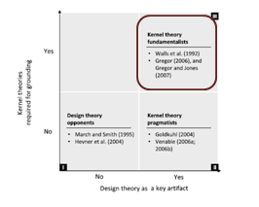
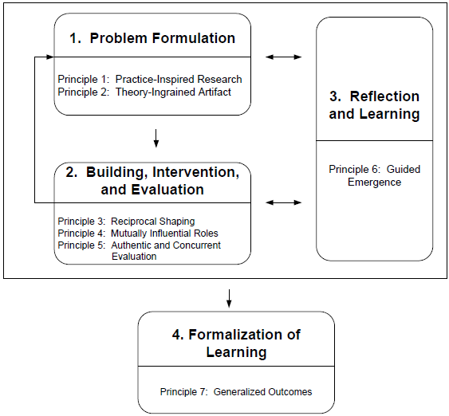
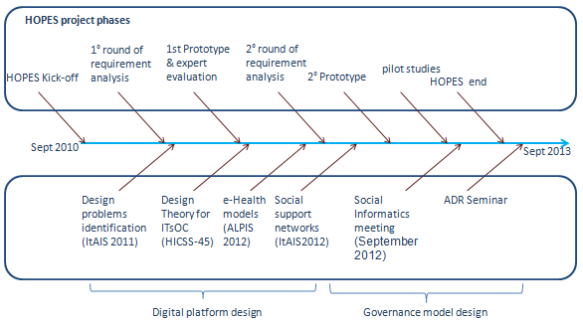
CeRSI’s research approach
Design Research Frameworks
Design & evaluation
Research
Projects
Design Research Process
Notes:
In these years the CeRSI research centre has always been characterized by its multidisciplinary focus on information system, a scientific area positioned at a crossroad between organizations and technology. The research model of CeRSI is based on building knowledge through the design and the evaluation of new artefacts in the context of innovative projects.

Slide 8
Research projects
Previous projects on e-Learning and Knowledge Management
Advanced Learning Platform for Hacking Absorption (submitted ISEC)
LiVES - Learning in Virtual and Extended Spaces (ITA)
EARNFILE- Evaluation And Recognition Of Non-Formal And Informal Learning (LLP-LdV)
AUTOMATIC - Development of curricula and innovative training tools for industrial automation systems for people employed in SMEs (LLP-LdV)
C4BIOIT - Campus For BioInformation technology (ITA)
OTIS - On-line Training for investment on Securities (VET-LdV)
TACIT - Technologies Augmenting Clinical InsighT (FP5)
Experience
more than 30 research projects in ten years, funded by:
EC: V-VII FP, AAL, Leonardo
National institutions: MIUR, FiLAS
Private companies: PAAdvice, Accenture, TXT, etc.
3 active projects currently running
Notes:
His vision with respect to the research on information systems can be summarized with this claim: “finalize the research to the design of an artefact or a social or organizational system, and to evaluate its possible organizational impacts”. His idea was that this way of working allows to address relevant problems, to engage in national and international cooperation with other universities and research institutions, and to investigate the design, the implementation processes, and the achievable outcomes in terms of organizational impacts, performance improvements, or similar produced by the change.
Following this line of action, in these years, the CeRSI research centre has been constantly active in collaborating to project proposals and partnering and/or coordinating more than 30 research projects funded both by the European Commission, and/or Italian institutions and private companies.
Such cooperation gave us the possibility to attract internationally reputed scholars, invited as visiting professor, to join the research centre and the faculty, and to offer research exchanges for PhDs and post-docs cooperating with the research centre.
In these years the CeRSI has matured a conspicuous research projects portfolio mainly on the topics of e-Business, e-Health, e-Government, and e-Learning. Currently there are six research projects active at the CeRSI, whose network of partners is shown in the right side of the figure. Detailed information on the projects are available on the posters currently presented in this room and later in the corridor. I encourage interested people to approach either me or one of my collegues at CeRSI if you are interested in specific project activities. These projects have contributed to ensure the daily operations of the CeRSI even after Alessandro Datri’s passing and will keep the centre up and running for the next year.

Slide 9
Focus Areas of Research
IT governance models, methods and tools
Organizational learning
Collaborative environments
Inf Inf
P1
A1
C4
A2
C5
C6
P2
A3
C1
C2
IT capability
Information Infrastructure
IT platform
IT application
C3

Slide 10
Organizational learning
North-Samardzic, A., Braccini A.M., Spagnoletti P. and Za S. (2014) Applying Media Synchronicity Theory to distance learning in Virtual Worlds: a Design Science approach. International Journal of Innovation and Learning
Winter R., Spagnoletti P., Za S. (2013) Exploring Foundations for Using Simulations in IS Research, International Conference on Information Systems, Milan 15-18 December
Marzo F., Za S., Spagnoletti P. (2013) Modeling dependence networks for agent based simulation of online and offline communities. In Advances in Practical Applications of Agent and Multi-Agent Systems, Y. Demazeau, T. Ishida, J. M. Corchado, and J. Bajo (Eds.), LNCS, vol. 7879, pp. 192-203, Springer
Za S., Spagnoletti P. (2013), Knowledge creation processes in Information Systems and Management: lessons from simulation studies, in Organization Change and Information Systems, Spagnoletti P. (Ed.), LNISO, vol. 2, Springer, Heidelberg

Slide 11
Informal Learning in the workplace (ILW)
Conceptualizing ILW
Learning resulting from daily life activities related to work, family, or leisure
Intentional or unintentional (tacit)
Digital technologies for ILW
Countinuous and ubiquitous exposure to external sources of knowledge (e.g. MOOCs, professional associations, Social Networks, etc.)
Digital tools for personalized learning: Adaptive Hypermedia Systems, Intelligeng Tutoring Systems
Needs for validation of ILW
Legitimation of workers’ competences
Assessment of organizational capabilities
Support professionalization processes and poligy making

Slide 12
ILW validation methods
Collecting Evidence
Examination
Declarative
Observation
Simulations
Evidence Extracted from Work (or other) Situations
Drawing evidence on outcomes of learning
Candidates answer questions on a domain of study
Candidates declare and justify skills. A panel (third party) gives the final judgement
An assessor (third party) observes candidates in situ and judges competences
Candidates are placed in a context that present characteristics of the real work situation
Candidates collect evidence of skills and competences in the real work situation

Slide 13
A Complex Adaptive Systems view on Informal Learning in the Workplace
ILW & CAS have the propensity for self-organization
ILW & CAS build hiearchies and structures to conserve resources
In ILW and CAS innovations emerge to solve problems
In ILW and CAS learning occurs in the face of environmental constraints

Slide 14
Research propositions
Informal learning is part of a process of adaptation in which digital tools (i.e. capabilities, applications, platforms) and information infrastructures facilitate communication, monitoring, and feedback
CAS theory provides a powerful lens for identifying patterns of behaviors and points of control for digitally enabled Informal Learning
locus of informal learning: internal vs external
feedback mechanisms: personal vs relational

Slide 15
The logical space of informal learning: expository instantiations
LinkedIn Skill endorsements
ResearchGate Score
CEPIS e-Competence Benchmark
MOOCs (e.g. Coursera) certificates
relational
Feedback
personal
Locus
internal
external

Slide 16
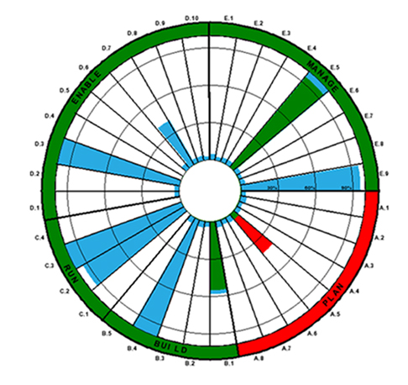
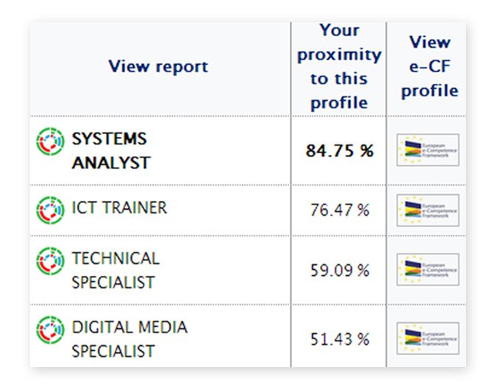
CEPIS e-Competence Benchmark
Features
Personal Competence Analysis Report
Matching e-Competences to ICT job profiles
Benchmarking against a EU standard
Informal Learning assumptions
Locus: internal
Feedback: personal
Validation method
Declarative
http://cepisecompetencebenchmark.org/

Slide 17
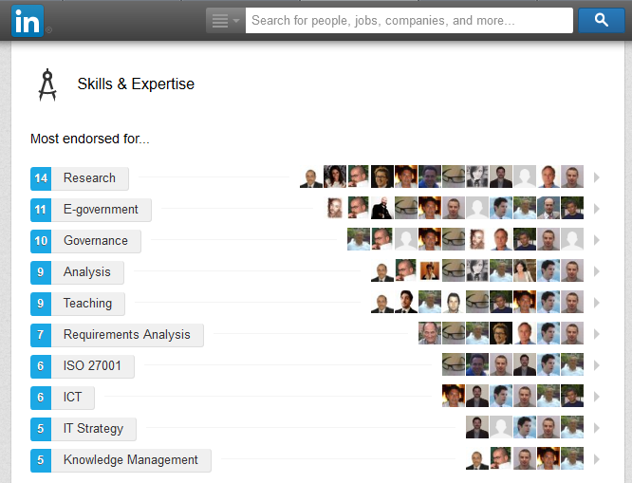
LinkedIn Skill endorsements
Features
Validation of strengths found in the profile from members of the professional network
Beeing in touch with peers by endorsing them
Informal Learning assumptions
Locus: internal
Feedback: relational
Validation method
Declarative
Observation
Evidence Extracted from Work
http://www.linkedin.com

Slide 18
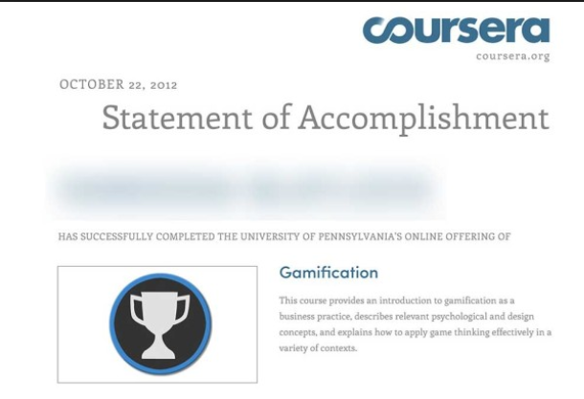
MOOCs (Coursera) certificates
Features
Statement of Accomplishment for Massive open online courses
Certificate signed by the instructor
Informal Learning assumptions
Locus: external
Feedback: personal
Validation method
Collecting Evidence
Examination
Observation
Simulations
http://www.coursera.org/

Slide 19
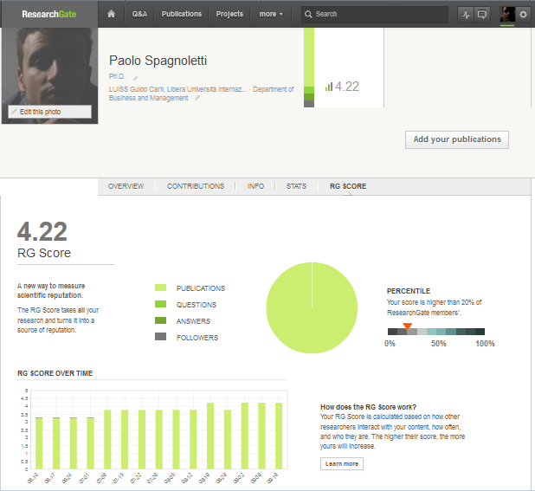
ResearchGate Score
Features
metric that measures scientific reputation based on how research is received by peers
The algorithm also looks at who these peers are
Informal Learning assumptions
Locus: external
Feedback: relational
Validation method
Collecting Evidence
Declarative
Observation
Evidence Extracted from Work
https://www.researchgate.net

Slide 20
Positioning validation methods in the logical space for Informal Learning
Declarative
Observation
Evidence Extracted from Work
Collecting Evidence
Declarative
Observation
Evidence Extracted from Work
Declarative
Collecting Evidence
Examination
Observation
Simulations
relational
Feedback
personal
Locus
internal
external

Slide 21
Conclusions
Implications for practice
Contingencies between validation methods and the context in which Informal Learning processes in the workplace are embedded
Design of formative contexts in which managerial practices and digital capabilities contribute to enhance knowledge, creativity, and innovation
Implications for research
Generative materiality of digital artifacts
Knowledge management and the resource based view of the firm

Slide 22
A worker centric perspective: from chaos to order
Internet
Learning object
Digital platforms
friend
Internet
Teacher
colleague
worker
Company
Internet
Information Infrastructures
University
Professional association
colleague
colleague
Internet

Slide 23
Selected references
Anderson, P. 2008. “Complexity Theory and Organization Science,” (10:3), pp. 216–232.
Andreu, R., and Ciborra, C. 1996. “Organisational learning and core capabilities development: the role of IT,” The Journal of Strategic Information Systems (5:2), pp. 111–127.
Boud, D., and Middleton, H. 2003. “Learning from others at work: communities of practice and informal learning,” Journal of Workplace Learning (15:5), pp. 194–202.
Colardyn, D., and Bjornavold, J. 2004. “Validation of Formal, Non-Formal and Informal Learning: policy and practices in EU Member States,” European journal of education (39:1), pp. 69–89.
Eraut, M. 2004. “Informal learning in the workplace,” Studies in Continuing Education (26:2), pp. 247–273.
Holland, J. 1998. Emergence: From chaos to order, Complexity, New York: Basic Books, p. 258.
Resca, A., Za, S., and Spagnoletti, P. 2013. “Digital platforms as sources for organizational and strategic transformation : a case study of the Midblue project,” Journal of Theoretical and Applied e-Commerce Research
Spagnoletti P., Za S., North-Samardzic A. Fostering informal learning at the workplace through digital platforms and information infrastructures (working paper)

Slide 24
Благодаря за вниманието

